Slide 1

Digital Marketing Trends You Can't Ignore in 2026
The marketing landscape is undergoing a seismic transformation. As we step into 2026, artificial intelligence, shifting consumer behaviors, and emerging technologies are reshaping how brands connect with audiences. This presentation explores the critical trends that will define marketing success in the year ahead.

Slide 2
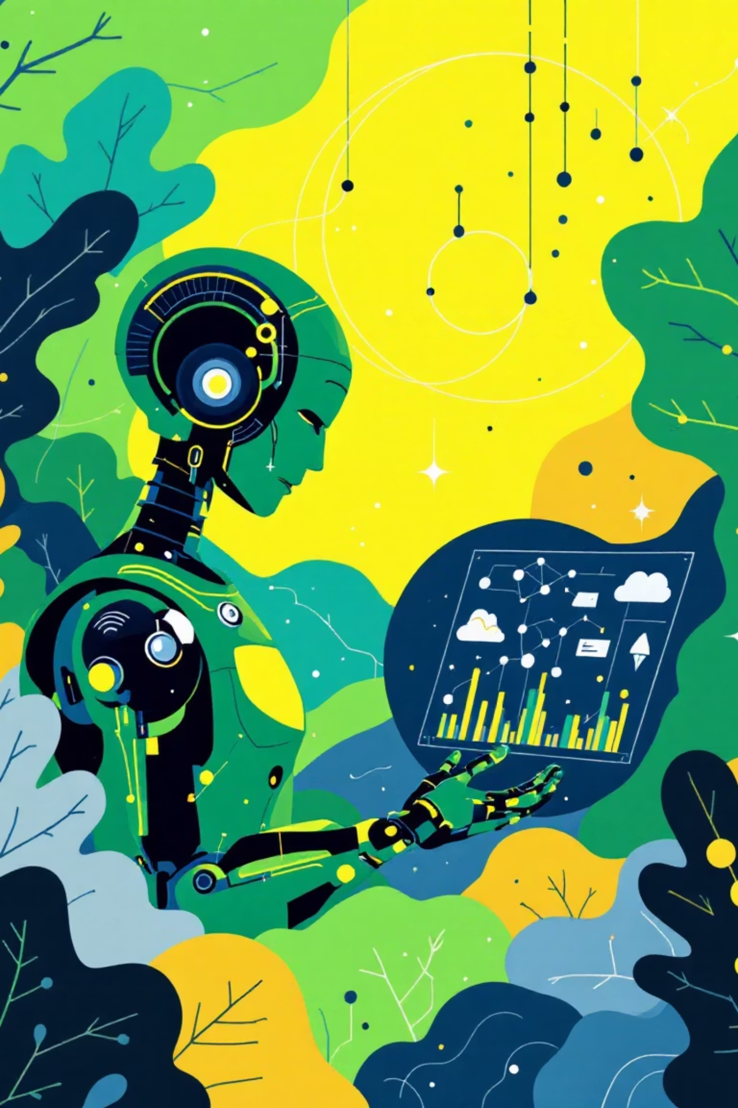
The New Marketing Landscape: AI and Consumer Evolution
AI Becomes Central
Consumer Behavior Shifts
Artificial intelligence is no longer just a supporting tool—it's now the core engine driving marketing workflows, content creation, and consumer behavior analysis. The shift from AI as novelty to AI as necessity marks a fundamental change in how marketing operates.
Today's consumers prioritize immediate gratification and present wellbeing over delayed rewards. This fundamental shift demands that marketers rethink campaign structures, messaging, and value propositions to align with instant-results expectations.
83%
2026
Daily Google & YouTube Users
The Watershed Year
Global consumers rely on these platforms daily, feeding AI unprecedented intent data
When AI understanding of consumer intent reaches critical mass

Slide 3


Marketers as Product Builders: The New Frontier
The traditional boundaries between marketing and product development are dissolving. Armed with sophisticated AI tools like Google AI Studio and Lovable, marketers are evolving into product managers who don't just promote—they create.
AI-Powered Prototyping
Ideation Phase
Using no-code AI platforms, marketers build functional prototypes in hours instead of months
Marketers identify customer pain points and opportunities through data analysis and consumer insights
Market Launch
Rapid Iteration
Products reach market faster with built-in marketing understanding from conception to completion
Customer feedback loops accelerate, enabling continuous product refinement and innovation

Slide 4


Generative Engine Optimization (GEO): The Future of SEO
Beyond Keywords
Traditional keyword bidding and optimization strategies are fading into obsolescence. The future belongs to brands that can create content AI systems trust, understand, and recommend through conversational search experiences.
Authoritative Content
Structured Data
People-First Approach
Create comprehensive, well-researched content that establishes domain expertise and builds AI trust signals
Implement schema markup and clear content hierarchies that help AI understand and categorize information
Write for humans first, ensuring natural language that AI recognizes as valuable and user-focused
Case Study: IKEA Kreativ AI
IKEA's Kreativ tool showcases GEO in action, enabling customers to visualize furniture in their spaces through AI-powered interactive discovery—making product information instantly accessible through conversational, visual search.

Slide 5




Human-First Content & E-E-A-T Remain King
Experience
Expertise
Demonstrate first-hand knowledge and real-world expertise through detailed case studies and personal insights
Showcase credentials, certifications, and specialized knowledge that establishes subject matter authority
Trustworthiness
Authoritativeness
Maintain transparency, cite sources, provide contact information, and demonstrate accountability in all content
Build reputation through consistent, high-quality content and recognition from industry peers and publications
Despite the proliferation of AI-generated content, authentic human stories and expert-driven insights continue to outperform generic content in both search rankings and audience engagement. Google's E-E-A-T framework—emphasizing Experience, Expertise, Authoritativeness, and Trustworthiness—has become the gold standard for content credibility. Brands must showcase real human voices, transparent credentials, and genuine intent to cut through the noise.

Slide 6

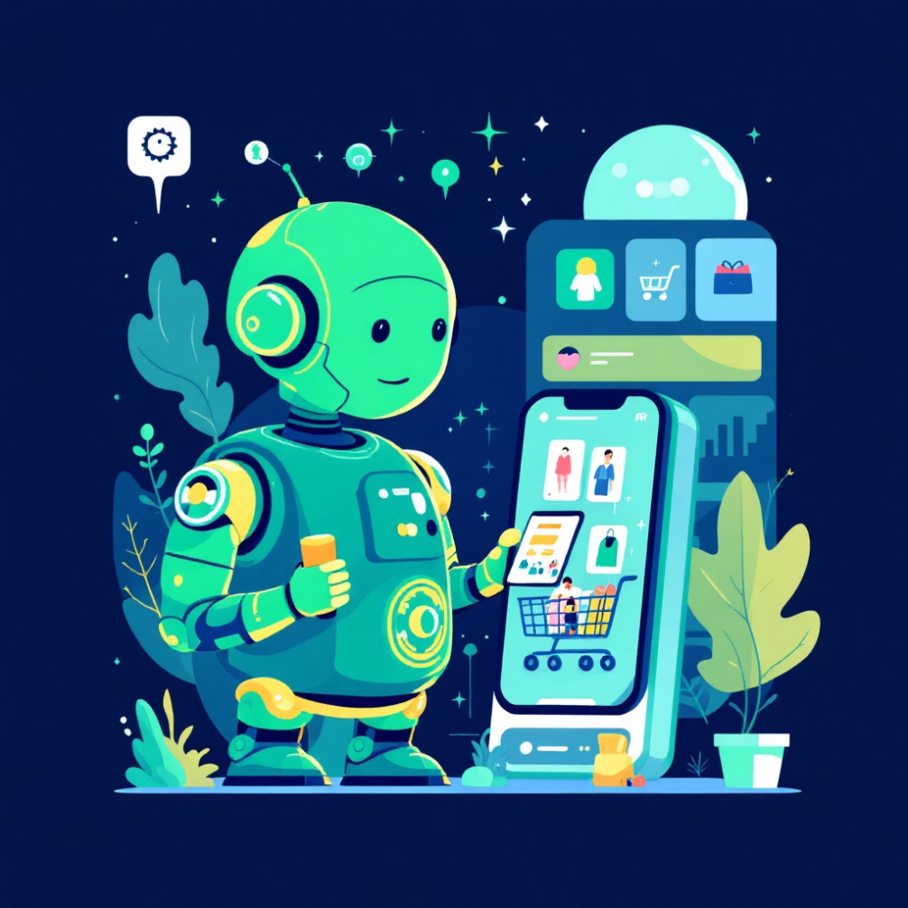
AI-Powered Consumer Agents: Marketing to Non-Humans
The Rise of AI Shopping Assistants
We're entering an era where brands must optimize for two audiences: human consumers and their AI agents. These autonomous shopping assistants now handle nearly a quarter of online purchases, acting as sophisticated proxies that evaluate options, compare prices, and make purchasing decisions.
This dual-audience reality requires brands to structure product information, reviews, and value propositions in ways both humans and algorithms can easily process and trust.
24%
AI-Driven Purchases
Online transactions completed by autonomous shopping agents
Optimize for Algorithms
Maintain Human Appeal
Build Agent Trust
Structure product data, specifications, and comparisons in machine-readable formats that AI agents can efficiently parse
Never lose sight of emotional resonance—even AI-facilitated purchases benefit from storytelling and brand connection
Ensure consistency across platforms, maintain accurate inventory data, and provide clear value propositions AI can verify

Slide 7
Social Media & Video Commerce Explosion
Social commerce has evolved from experimental feature to primary revenue channel. Platforms like TikTok Shop and Instagram Shops have transformed social media into full-featured marketplaces, enabling seamless in-app purchasing and live-stream shopping events that blend entertainment with instant gratification.
Short-Form Video Dominance
Meta's AI Revolution
Brief, engaging video content continues to drive unprecedented engagement and conversion rates. Brands that master the art of storytelling in 15-60 second formats capture attention in an increasingly fragmented media landscape.
Meta's evolving AI advertising tools and algorithm changes are reshaping content visibility and campaign performance. Understanding these shifts is crucial for maintaining organic reach and paid advertising ROI.
Authentic, unpolished content outperforms high-production commercials
AI-powered ad targeting becomes more sophisticated and privacy-conscious
User-generated content drives trust and purchase intent
Algorithm prioritizes meaningful interactions over passive consumption
Behind-the-scenes and educational formats perform exceptionally well
Brands must adapt content strategies to changing visibility rules

Slide 8




Voice & Visual Search Optimization
Voice Search Growth
Local & Natural Language
Visual Search Tools
Smart assistants become ubiquitous in homes and vehicles, making conversational queries the new normal
Content must answer questions naturally and prioritize local relevance for "near me" queries
Multi-modal search enables users to explore products through images and video
Multi-Modal Search Behavior
Tools like Google's Gemini Nano enable immersive, multi-modal consumer exploration—combining voice, image, and text inputs for richer search experiences. The "Banana" demo showcased how users can point their camera at objects and receive instant, contextual information.
Marketers must optimize content across formats: conversational FAQs for voice, high-quality product images for visual search, and structured data that connects all modalities seamlessly.

Slide 9

Ethical Marketing & Data Privacy as Non-Negotiables
Consumer trust has become the most valuable currency in digital marketing. As data breaches and privacy concerns dominate headlines, brands that prioritize ethical data practices and transparent communication gain significant competitive advantages.
Transparency First
Purpose-Driven Content
Sustainability Storytelling
Clearly communicate data collection practices, use cases, and consumer rights in plain language that builds confidence
Authentically connect brand values to social and environmental causes that resonate with conscious consumers
Showcase genuine commitment to sustainable practices through measurable actions, not just marketing claims
Gen Z & Millennial Expectations
These demographics demand brands take clear stances on social issues and demonstrate accountability. Purpose-driven marketing isn't optional—it's expected. Brands that authentically embrace ethical practices attract loyal communities willing to advocate and pay premium prices.

Slide 10
2026 and Beyond: Embrace Change, Build Connection
Blend Innovation with Authenticity
Deliver Immediate Value
The brands that win will master the balance between cutting-edge AI capabilities and genuine human connection. Technology amplifies relationships—it doesn't replace them.
Focus on creating interactive experiences that provide instant gratification while building long-term brand equity. Every touchpoint should offer clear, tangible value.
Build Trusted Content Ecosystems
Evolve from Campaigns to Journeys
Invest in authoritative, people-first content that serves both human readers and AI systems. Quality and credibility compound over time.
Your marketing strategy must transform from isolated campaigns into continuous, AI-empowered customer journeys that adapt in real-time to individual needs and behaviors.
Let's lead the future by putting people and technology at the heart of everything we do.
The future of marketing belongs to those who embrace change while never losing sight of the human element. As we navigate 2026, success will come from strategic adoption of emerging technologies paired with unwavering commitment to authentic connection, ethical practices, and genuine value creation.

